Slide 1
Wayne Assistive Technology Team (WATT)
Coordinating Council
September 20, 2018

Slide 2
What is Assistive Technology?
Any item, piece of equipment, software, or product system that is used to
increase
maintain and
improve
the functional capabilities of individuals with disabilities.

Slide 3
Assistive Technology allows students to access curriculum, communication, and the environment.

Slide 4
IDEA requires that the Individualized Education Program (IEP) Team consider the need for assistive technology devices and services.

Slide 5
Assistive Technology in Wayne County before
ATRC: Serving Western Wayne, Dearborn, and Downriver
ATTIC: Serving Detroit and Eastern Wayne

Slide 6
Assistive Technology in Wayne County now
ATRC and ATTIC merged
New location
Part of Wayne RESA
WATT

Slide 7
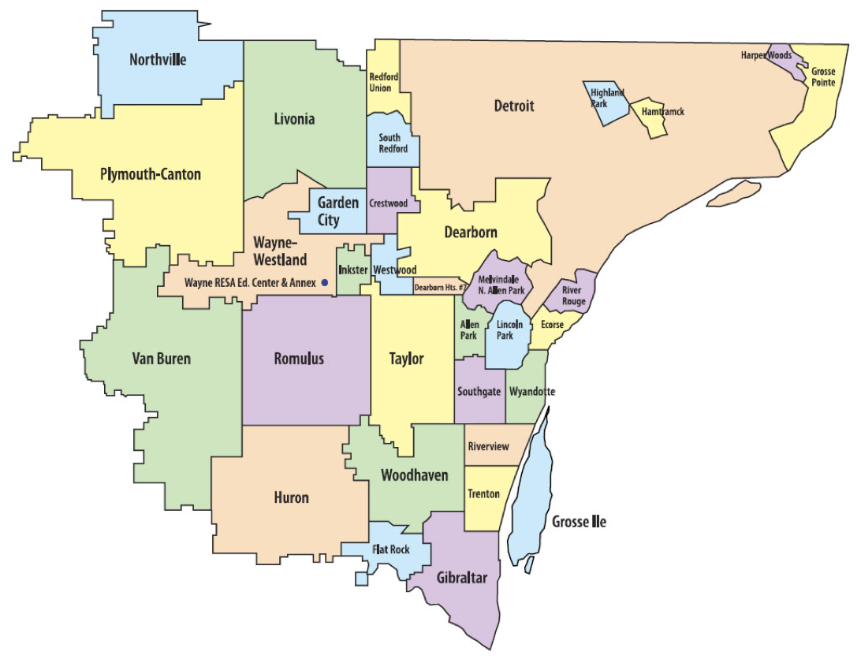
Who We Serve

Slide 8
Benefits of Merger
Collaboration of resources
Professional Development is open to all of Wayne county
One-stop resource for AT
Continuity of AT services throughout county
Expanded opportunities for capacity building at the individual, building, district, and county levels.

Slide 9
What WATT Offers...
Assistive technology consultation and support
AT evaluations for students with low incidence disabilities
Lending library with devices, software, and reference materials
In-service training for educators, parents, and students
WATT Workroom
Poster printer
Laminator
Book binder
Supplies

Slide 10
What WATT Offers...
Support and coaching in integrating assistive technology into the curriculum
Information on the latest technology, software, and web resources
Adaptations including switches, environmental aids, and mounting systems for student use
Information and assistance with the Universal Design for Learning (UDL) framework

Slide 11
Lending Library
Curriculum
Laptops/Chrome-books
iPads & Apps
Communication Devices
Single message devices
Sequential message devices
GoTalk devices
Adapted Toys
Adapted Computer Hardware
Software
Online subscriptions
Mounts
Alternative and Augmentative Communication (AAC) Supports

Slide 12
New Location
WATT
29115 Carlysle
Inkster, MI 48141
west end of Burger-Baylor
RESA satellite location
Phone : 734-334-1701

Slide 13
WATT 734-334-1701
Laura Begley, CCC-SLP AT Coordinator | begleyl@resa.net 734-334-1706
Derrick Graves AT Coordinator | gravesd@resa.net 734-334-1705
Kathleen Mooradian AT Coordinator | moorad@resa.net 734-334-1704
Christine Skoglund AT Coordinator | skoglum@resa.net 734-334-1707
Beverly Rodgers Administrative Assistant | rodgerb@resa.net 734-334-1703

Slide 14
WATT Open House
Thursday, November 1st
2:30 pm- 6:00 pm
Visit us at our new location, meet the AT Coordinators, and see what we have to offer.

Slide 15
Questions?

